Slide 1
<PHP> FINAL PRESENTATION
<DMITRI ATANASOV>
<SUPERVISOR: NAGAT DRAWEL>

Slide 2
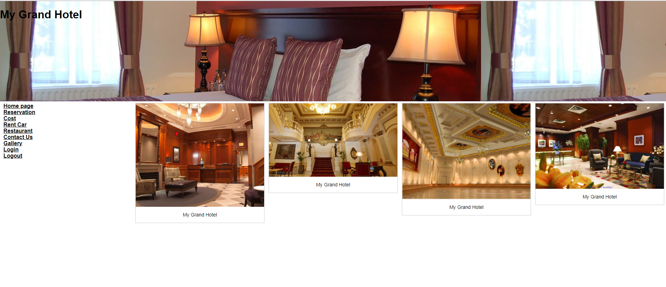
Grand HOTEL

Slide 3
Background / INTRODUCTION
This website is created for the tourist business.
Our customers can reserve a room directly from the site, as well as reserve a car or order food in the room.
There is a room view option.
The user can login, logout, register.
On our site you can see the photos of our menu.

Slide 4
Requirement Analisys and specification:
Xampp
Notepad++
HTML
SQL Query
CSS
PHP

Slide 5
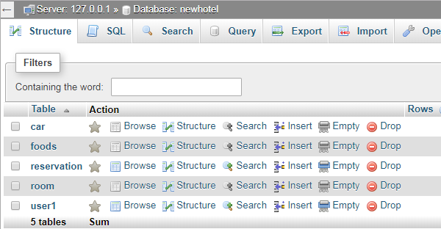
Design
I have a Database – “newHotel”
My database contains tables :
Car / Food / Reservation / Room / User1

Slide 6
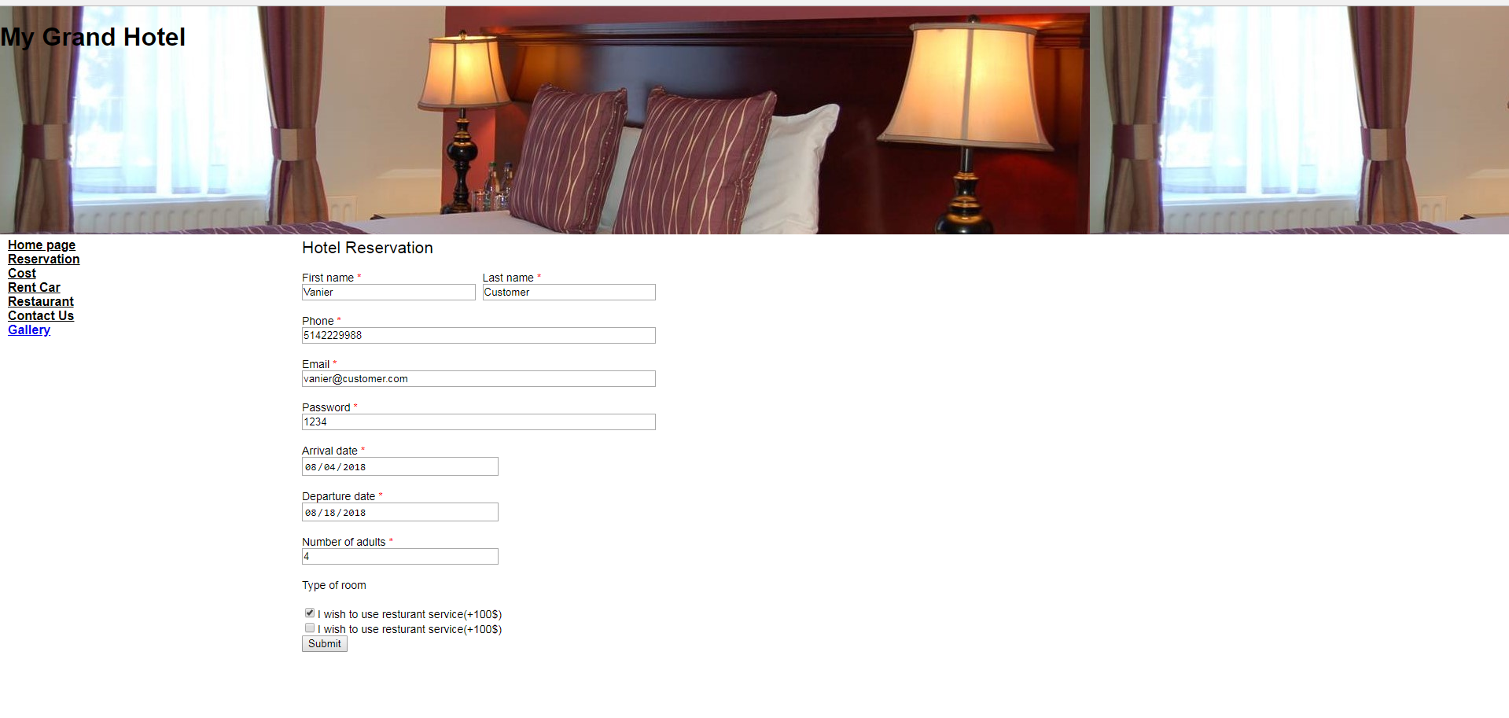
Creating new customer

Slide 7
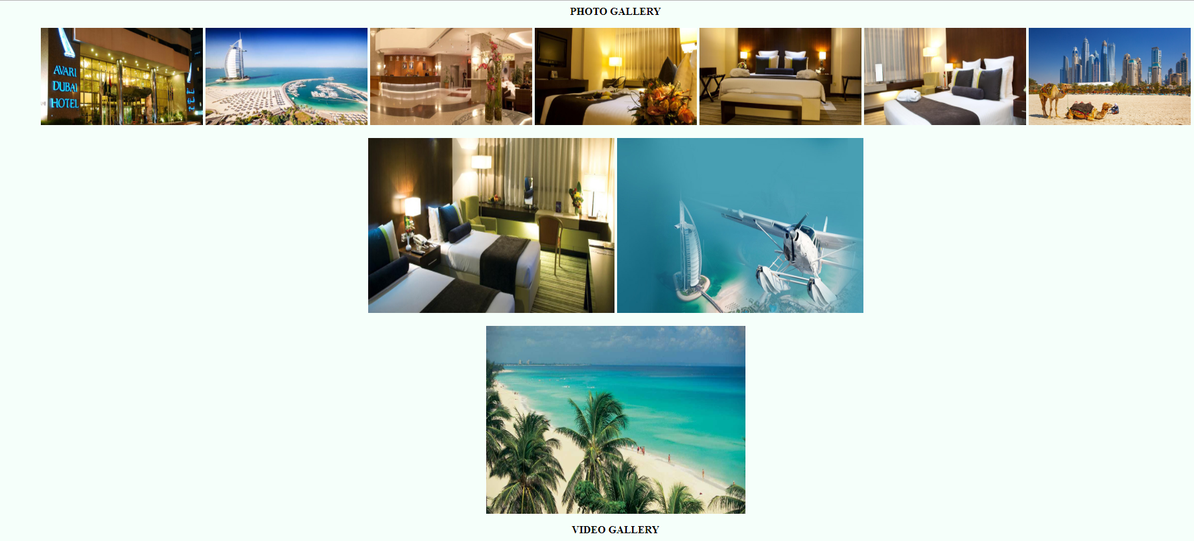
Photo gallery

Slide 8
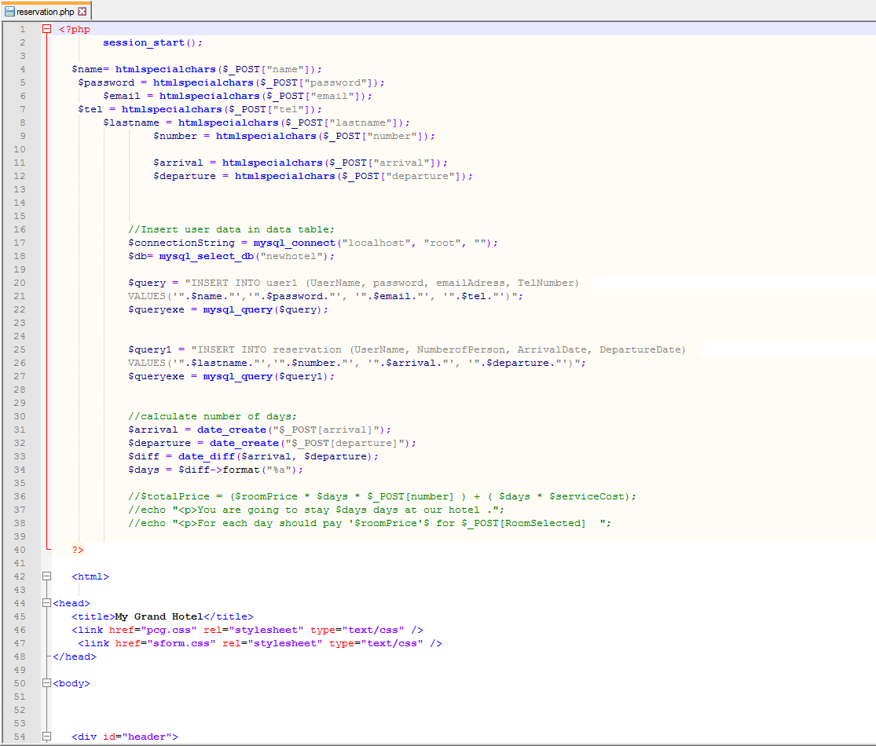
reservation

Slide 9
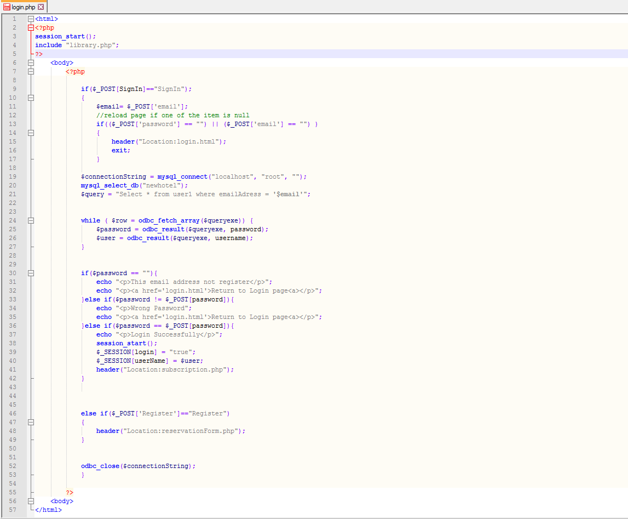
Login page

Slide 10
Vanier college
THE END THANK YOU

